Slide 1
Describing a person theory

Slide 3
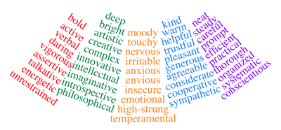
Useful adjectives
Describing someone’s character
Notes:
Useful adjectives
Describing someone’s character

Slide 4
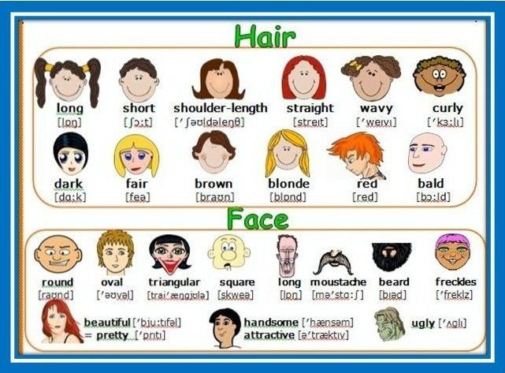
Describing physical appearance
Notes:
Describing physical appearance

