Slide 1
CHRISTMAS TRADITIONS
UNIT 1:Introduction
Instructor: Paraskevi vasiliadou

Slide 2
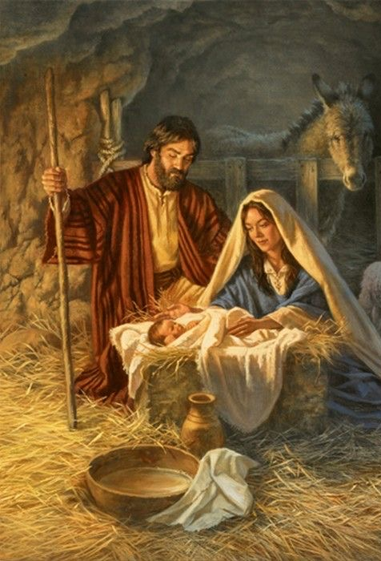
Christmas is celebrated on December 25th, and it is a season of joy, happiness and peace. It is an important holiday as we celebrate the birth of Jesus Christ, according the Christian religion. It is a season full of traditions, some shared all around the world.

Slide 3
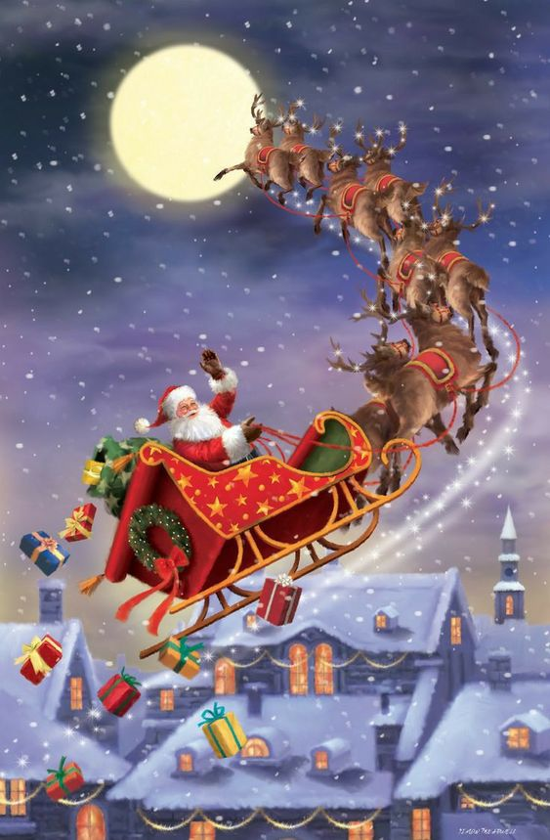
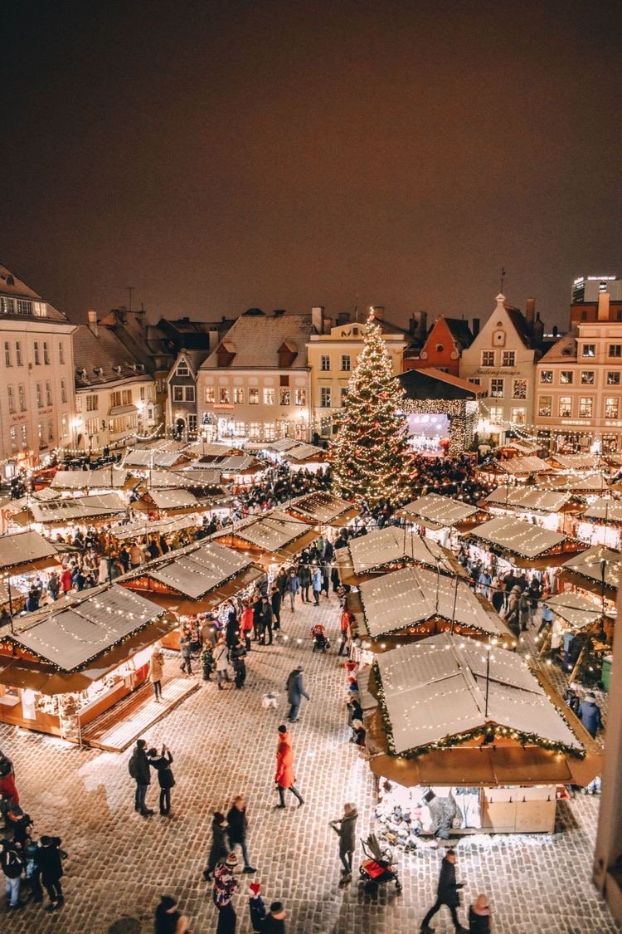
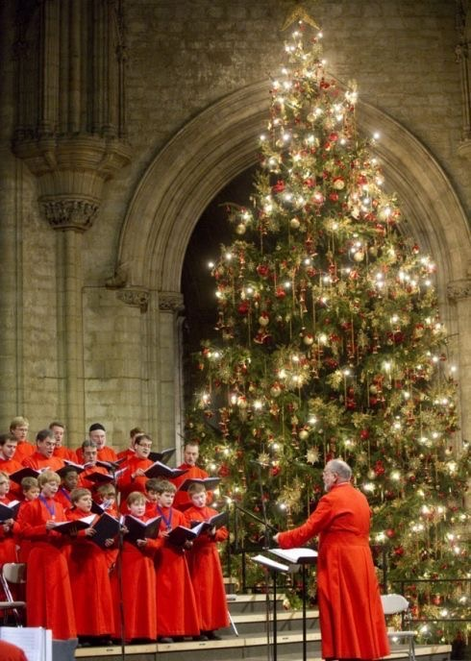
Christmas traditions include a variety of customs, religious practices, rituals, and folklore associated with the celebration of Christmas. Many of these traditions vary by country or region, while others are practiced in a virtually identical manner across the world.

Slide 4
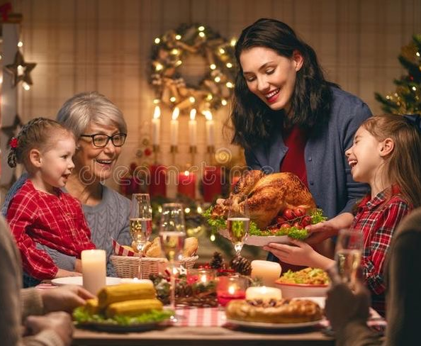
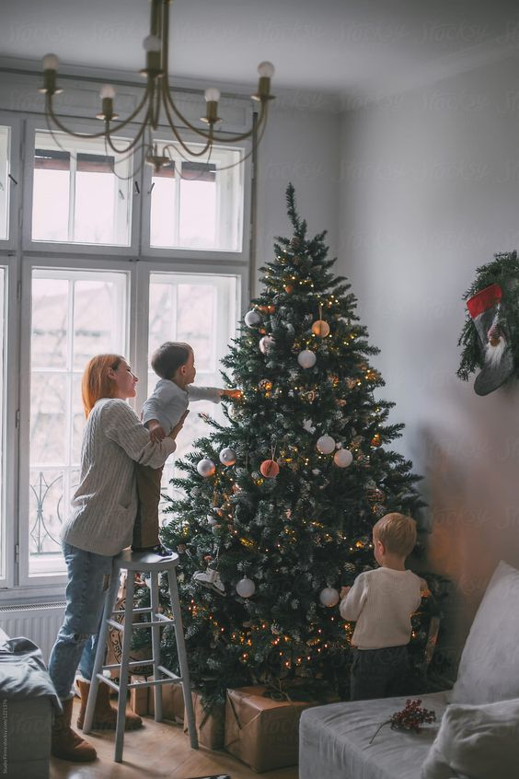
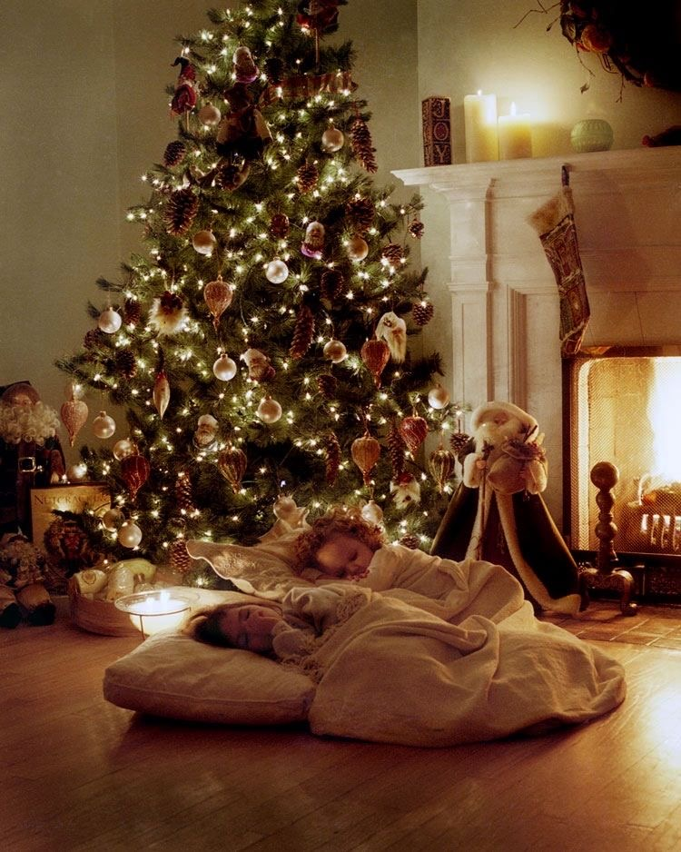
Popular customs include exchanging gifts, decorating Christmas trees, attending church, sharing meals with family and friends and, of course, waiting for Santa Claus to arrive.

Slide 5
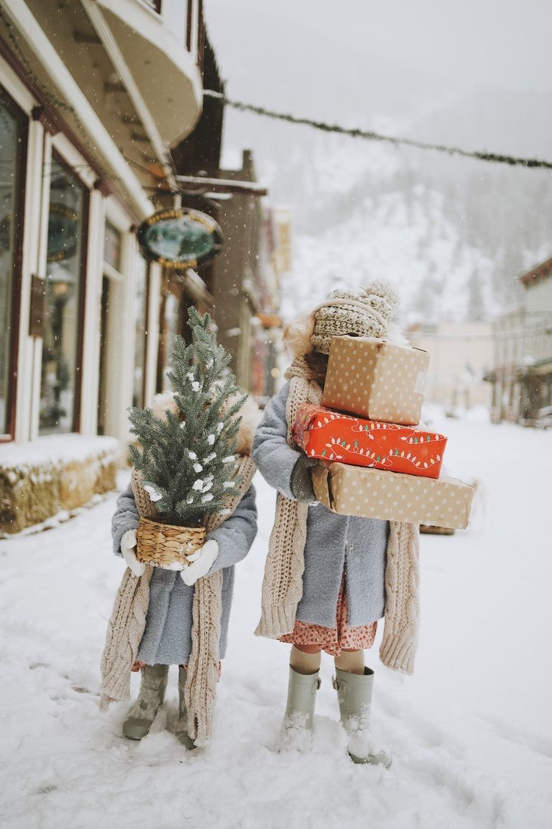
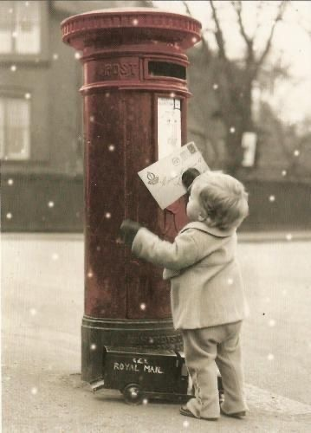
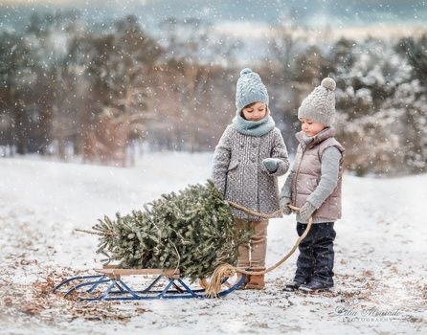
Many traditions go back to ancient times. Traditions have changed and evolved through the centuries

Slide 6
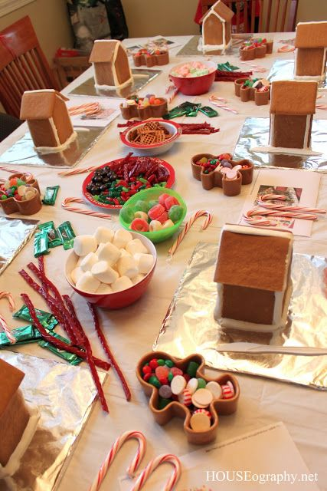
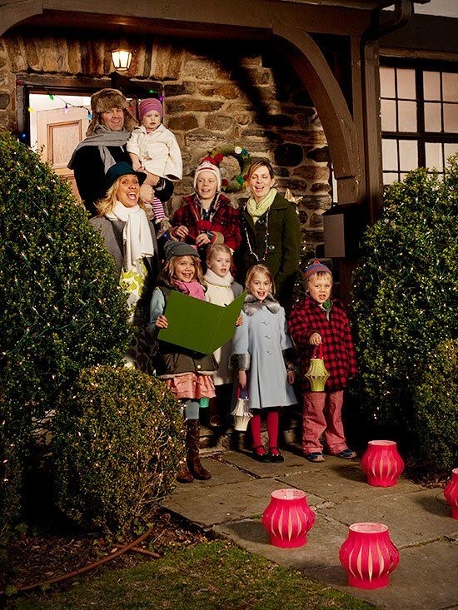
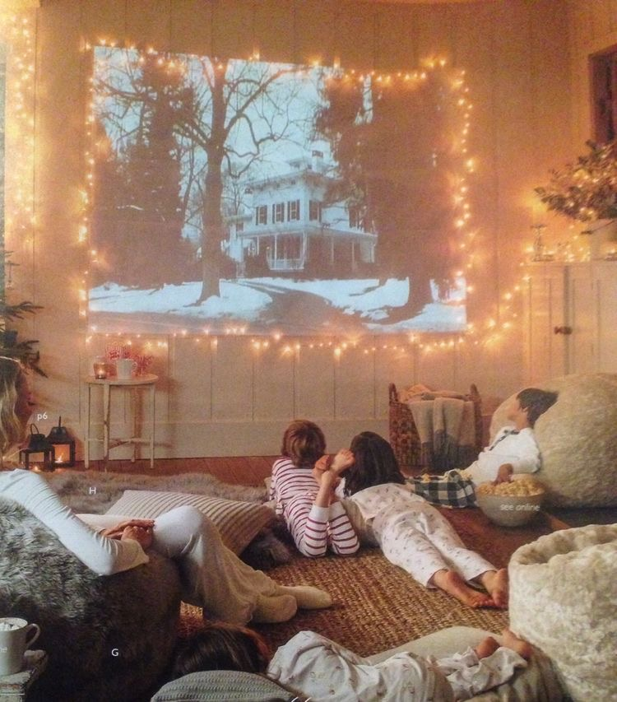
CHRISTMAS TRADITIONS

Slide 7
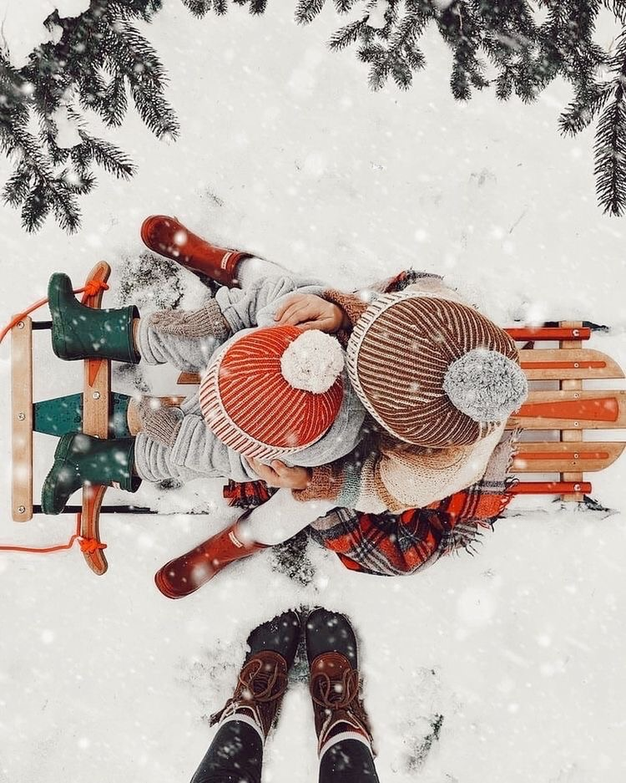
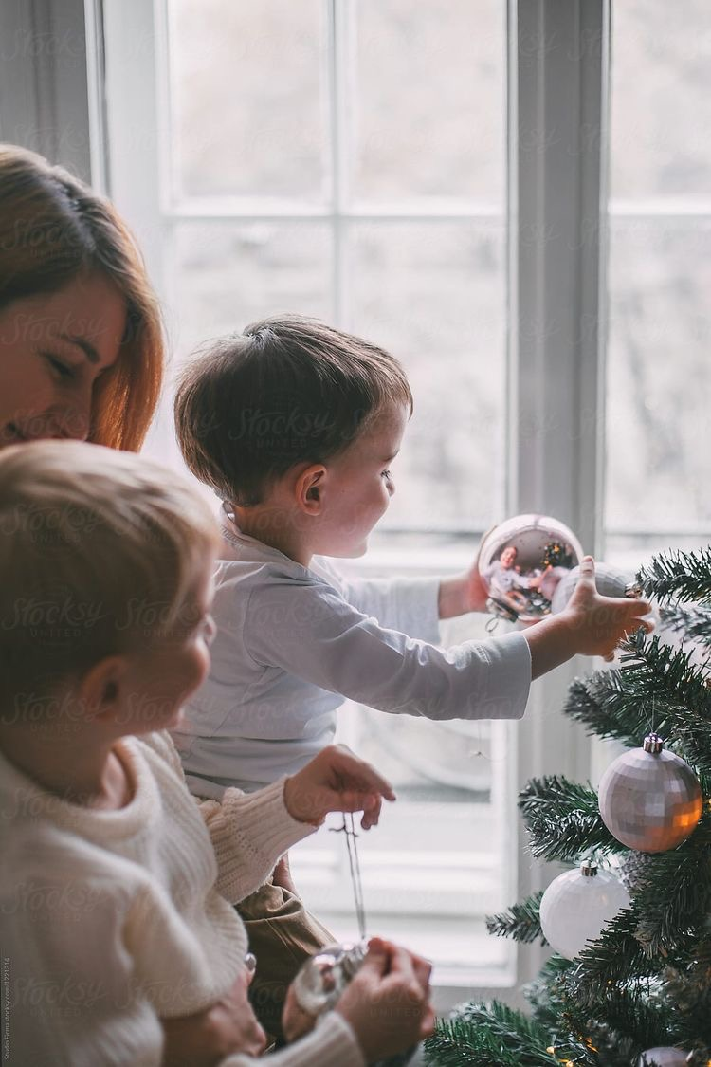
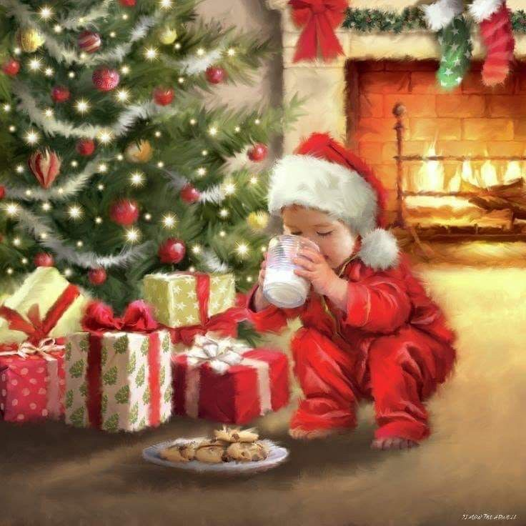
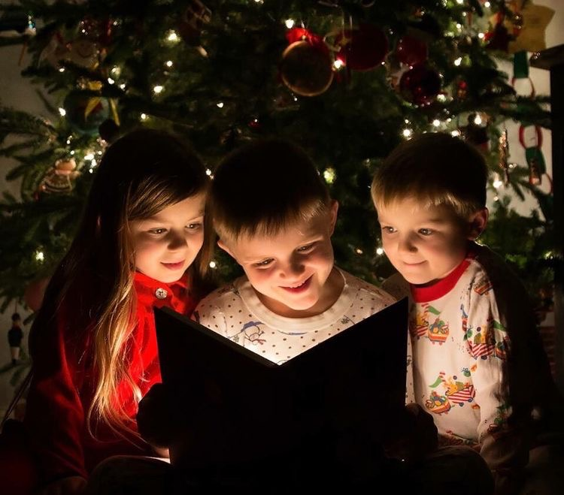
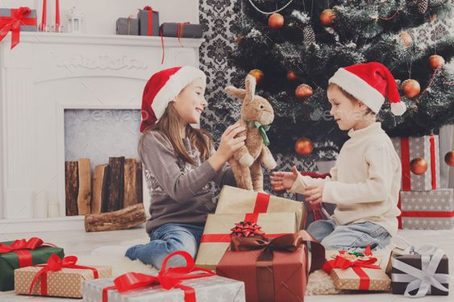

Slide 8
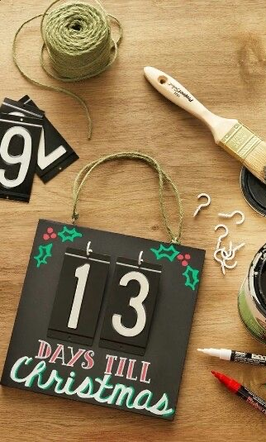
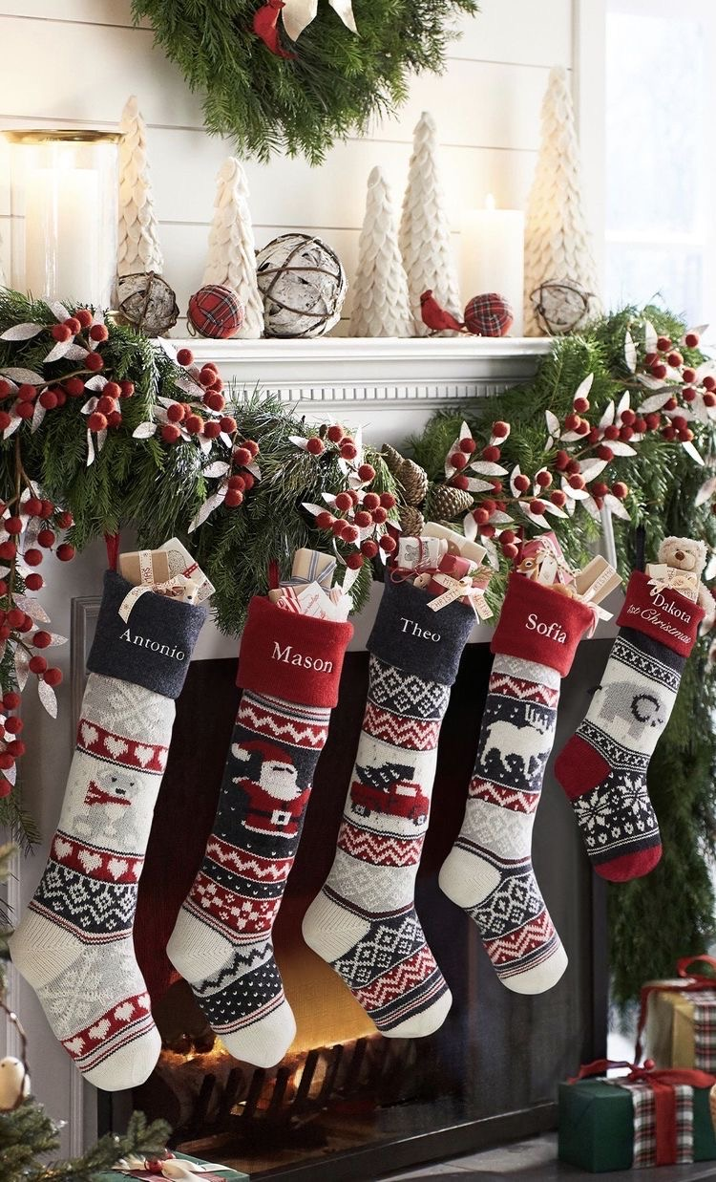
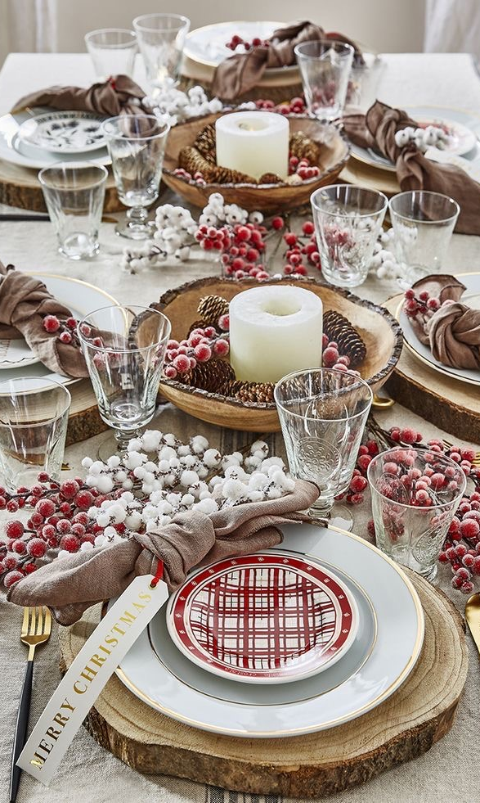

Slide 9
REFERENCES:
https://www.history.com/topics/christmas/history-of-christmas
https://en.wikipedia.org/wiki/Christmas_traditions
https://www.insider.com/origins-of-common-christmas-traditions-2017-12

